Slide 1
Speaker Notes
This lab is optional and not always recommended. Please see the speaker notes
Instructors are strongly encouraged to watch the App Camp videos and complete the labs before delivering or proctoring App Camp! https://aka.ms/app-camp
Instruct your students to do the labs at that same location – https://aka.ms/app-camp
⬇️ Don’t forget to check the speaker notes! ⬇️
Notes:
Most students should begin by completing the “A Path” (labs A-01 – A-03).
This deck is for the alternative “B Path” (Labs B-01 – B-04).
USE THE “A” PATH IF YOUR STUDENTS:
- already use Azure AD for authentication
- do not authenticate users
- are building new applications
USE THE “B” PATH IF YOUR STUDENTS: - want to build a Teams app based on an existing app that uses a non-Azure AD identity system such as Auth0, Identity Server, Okta, Ping Federate, or Azure AD B2C, or a bespoke identity system such as ASP.NET SQL based authentication
The solution files for the extended labs are all built on the A-03 solution; they have been tested building on B-04 but students will need to understand the code and adapt the instructions in order to make this work.
The extended labs can be done in any order, although not all the permutations have been tested. The /src/extend-with-capabilities/All folder contains the result of completing all of the extended labs and is useful for demonstration purposes.

Slide 2
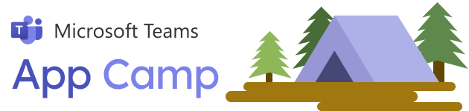

Lab B01 Start with a non-Azure AD Identity System
Notes:
Most students should begin by completing the “A Path” (labs A-01 – A-03).
This deck is for the alternative “B Path” (Labs B-01 – B-04).
USE THE “A” PATH IF YOUR STUDENTS:
- already use Azure AD for authentication
- do not authenticate users
- are building new applications
USE THE “B” PATH IF YOUR STUDENTS: - want to build a Teams app based on an existing app that uses a non-Azure AD identity system such as Auth0, Identity Server, Okta, Ping Federate, or Azure AD B2C, or a bespoke identity system such as ASP.NET SQL based authentication
The solution files for the extended labs are all built on the A-03 solution; they have been tested building on B-04 but students will need to understand the code and adapt the instructions in order to make this work.
The extended labs can be done in any order, although not all the permutations have been tested. The /src/extend-with-capabilities/All folder contains the result of completing all of the extended labs and is useful for demonstration purposes.

Slide 3

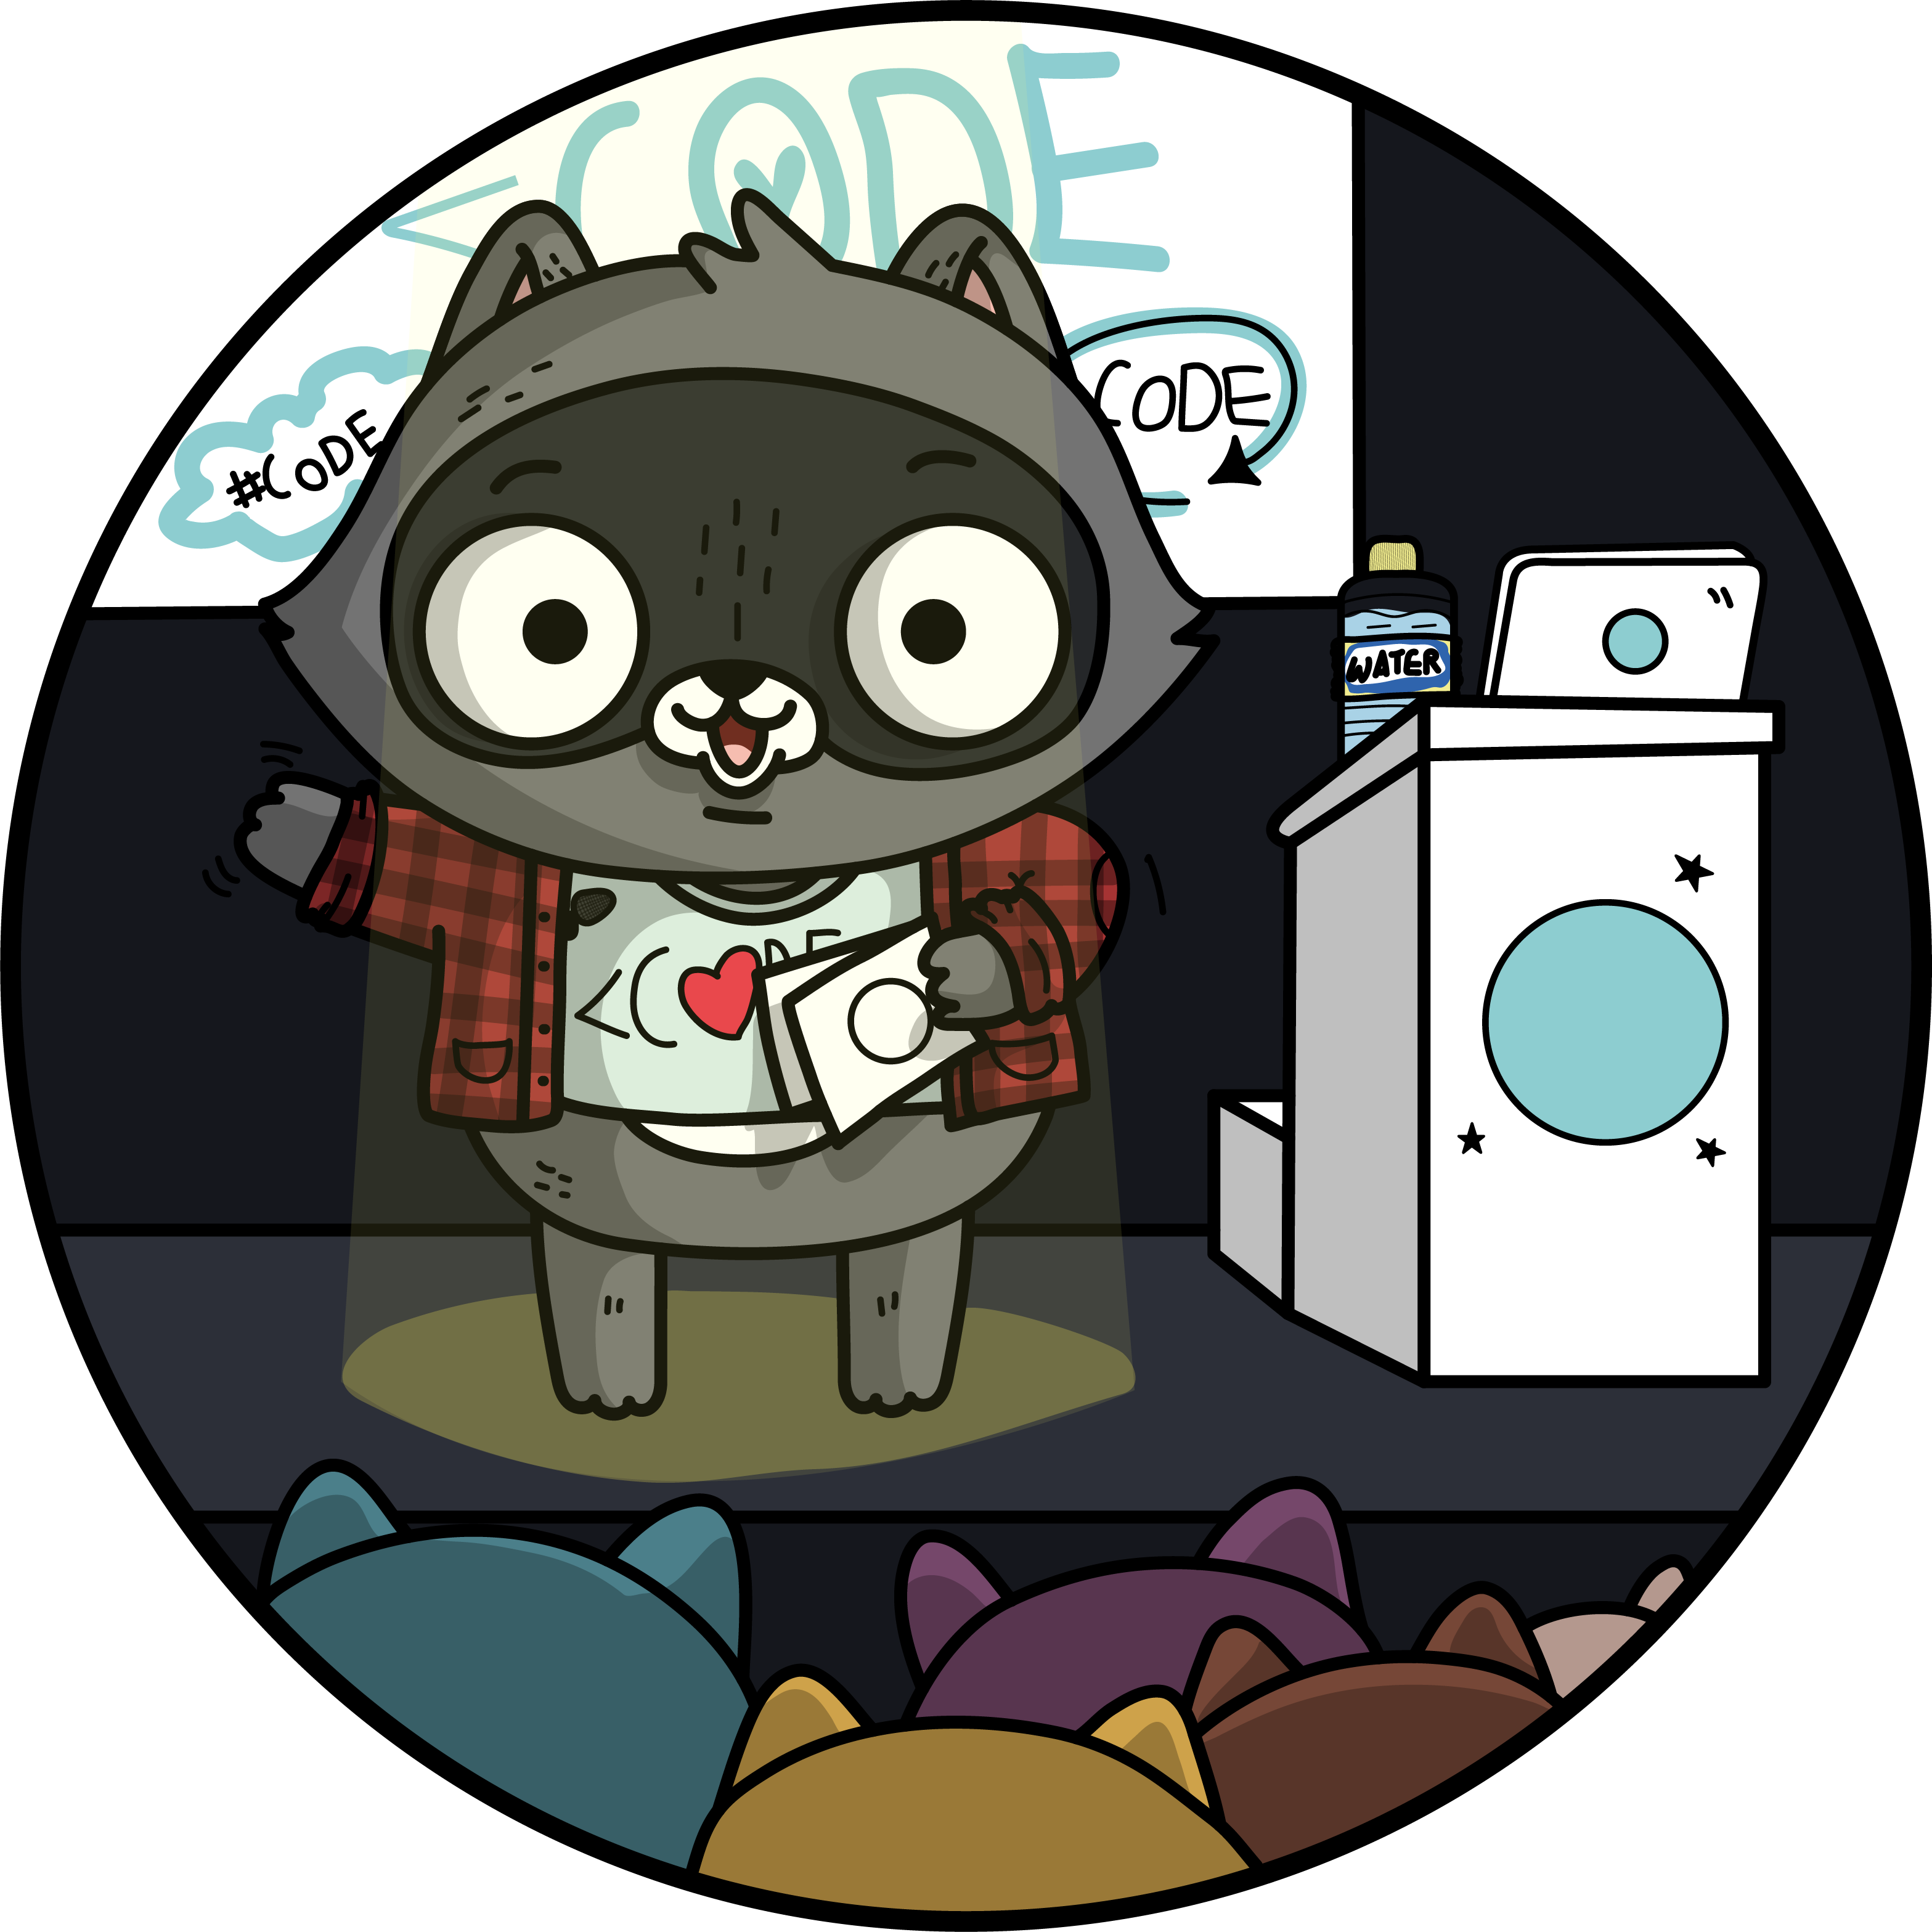
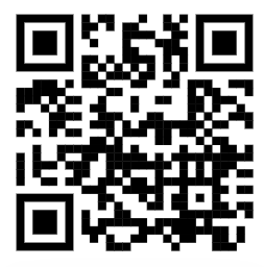

App Camp Labs
Core Lab (path A)
App setup
Add tab with SSO
Add look and feel
Core Lab (path B)
App setup
Add tab with SSO
Add look and feel
App setup no AAD
Migrate a non-Azure AD Web App to Teams
Migrate an Azure AD Web App to Teams
start
B-01
B-02
https://aka.ms/app-camp
B-03
Personal tab w/Azure AD SSO
B-04
Core Teams Application
Extend capabilities
Configurable tab
Messaging Extension w/Adaptive Cards
Deep links
Task modules
Monetization
Tab in Meeting
Notes:
Most students should begin by completing the “A Path” (labs A-01 – A-03).
This deck is for the alternative “B Path” (Labs B-01 – B-04).
USE THE “A” PATH IF YOUR STUDENTS:
- already use Azure AD for authentication
- do not authenticate users
- are building new applications
USE THE “B” PATH IF YOUR STUDENTS: - want to build a Teams app based on an existing app that uses a non-Azure AD identity system such as Auth0, Identity Server, Okta, Ping Federate, or Azure AD B2C, or a bespoke identity system such as ASP.NET SQL based authentication
The solution files for the extended labs are all built on the A-03 solution; they have been tested building on B-04 but students will need to understand the code and adapt the instructions in order to make this work.
The extended labs can be done in any order, although not all the permutations have been tested. The /src/extend-with-capabilities/All folder contains the result of completing all of the extended labs and is useful for demonstration purposes.

Slide 4
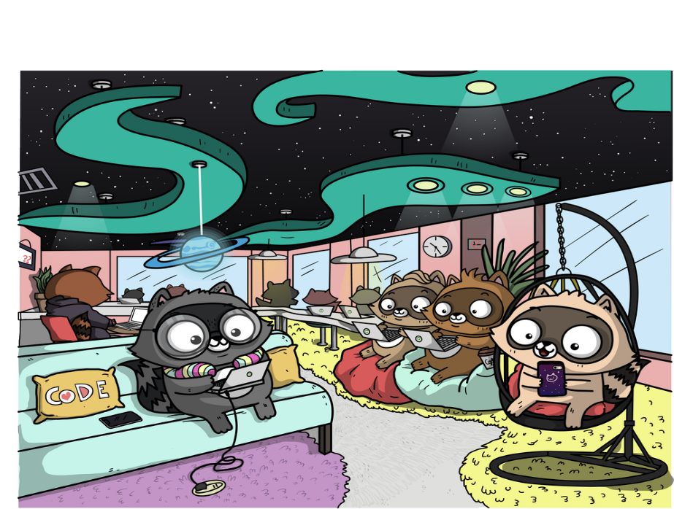
What to bring to App Camp
Administrator rights in a non-production Microsoft 365 tenant (FREE TENANT: https://aka.ms/join-m365-dev-program)
NodeJS
A code editor (if you ask us, we really like Visual Studio Code!)
ngrok, a tunnelling program that allows you to access your local web
https://aka.ms/app-camp/prerequisites
Notes:
These are the prerequisites for doing the labs.
Lab B-01 will lead you through the setup

Slide 5






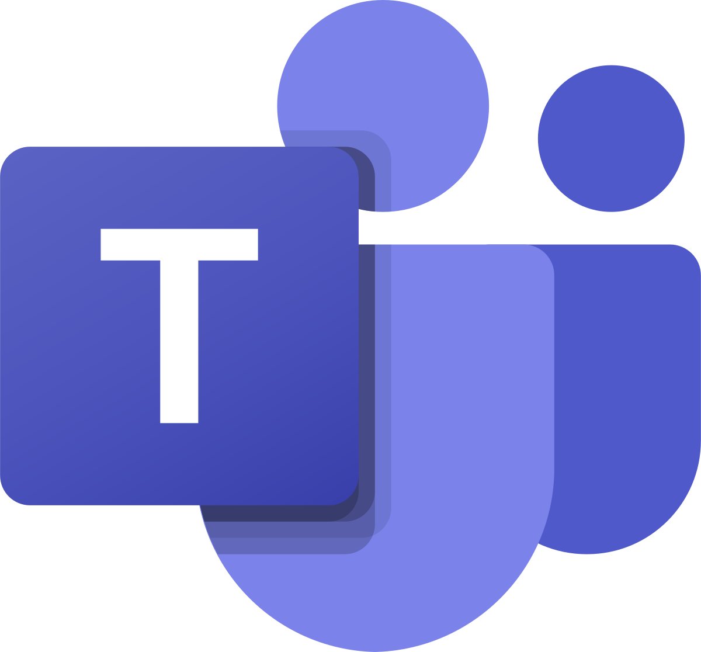


Teams developer setup
Your computer
FIREWALL
Office 365
Microsoft 365 Data
Local
Web
server
HTTPS / 443
Microsoft
Graph API
HTTP / 80
Teams client or web-browser
To make this work we need:
HTTPS termination
Valid host name
Easy mobile testing
Your local web app
Your local bot app
Notes:
The app will run in NodeJS in your local web server.
In theory, you could run it like this – so long as you set up SSL on your web server. In this case, the web pages and backing web service would use a local URL, making only outbound access through whatever firewall you have in place.

Slide 6

Teams developer setup
Your computer
FIREWALL
Office 365
Microsoft 365 Data
Local
Web
server
HTTPS / 443
Microsoft
Graph API
HTTP / 80
Teams client or web-browser
Microsoft
Bot Service
Teams communicates with your app via the Microsoft Bot Service
HTTPS / 443
To make this work we need:
HTTPS termination
Valid host name
Easy mobile testing
Your local web app
Your local bot app
Tunnel for access by Microsoft Bot Framework
Notes:
But there are features of Teams apps that use the Microsoft Azure Bot Channel Service. This service needs to initiate HTTP requests to your app’s back-end service, but in a typical development environment, they will be blocked by your firewall.

Slide 7
Teams developer setup
Your computer
FIREWALL
Office 365
Microsoft 365 Data
Local
Web
server
HTTPS / 443 / graph.com
Microsoft
Graph API
HTTP / 3978
/ localhost
ngrok tunnel
HTTPS / 443 / ngrok.io
Teams client or web-browser
Microsoft
Bot Service
HTTPS / 443 / ngrok.io
Teams communicates with your app via the Microsoft Bot Service
HTTPS / 443 / smba
To make this work we need:
HTTPS termination
Valid host name
Easy mobile testing
Your local web app
Your local bot app
Tunnel for access by Microsoft Bot Framework
Notes:
To solve this issue, we’ll use a tunneling tool called ngrok which will open a port from the Internet to the NodeJS web server running on your development machine.
Ngrok also handles host naming and SSL termination, so it’s easier to just use it for all access to your application, so that’s how the labs are written.
If you’re not permitted to run ngrok, or if it’s blocked in your enterprise’s firewall, you’ll need to either run the labs somewhere else or adapt them (in which case the Message Extension lab and any others that use the Bot framework won’t work). There are videos in the Lab A-01 (and B-01) instructions with details.

Slide 8
Teams developer setup
Your computer
FIREWALL
Test your local dec setup
Download & unzip the ZIP file
Open the folder in a command line
Run ngrok
>ngrok http 3978
Run node server.js
>npm install
>node server.js
On your web browser, copy/paste the ngrok.io URL - you should see the welcome message “A Simple Node.js Server is Up and Running.......”
Local
Web
server
HTTP / 80 / localhost
ngrok tunnel
Teams client or web-browser
HTTPS / 443 / ngrok.io
Your local web app
Your local bot app

Slide 9
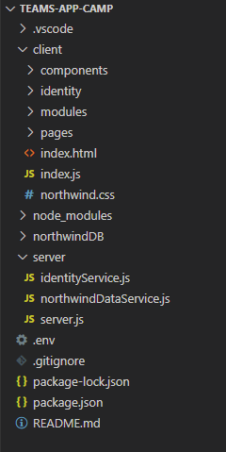
Code dive into Northwind app
Client application composed of HTML / JS / CSS files
This is where most of the chages will happen
App “database” made of JSON files
Server application that serves the static pages, exposes the API and manages the authentication
Environment file for your app configuration settings
Notes:
Explain the code structure
Show server/server.js; point out that in addition to handling web service calls, the line
app.use (express.static(‘client’)); serves the client folder as static files.

Slide 10

demo
Notes:
Lab demonstration:
- Show your working directory – ensure students understand they should copy the B-01 solution folder to a new working folder
- Run the app and show it working in a web browser (having completed lab B-01). Show how the simple login system works
- Show /src/create-core-app/bespoke/B01-begin-app/server/identityService.js and scroll to the validateApiRequest() function (~line 32). Point out that though it’s not secure it is “validating” each API request based on an employee ID in a cookie.

Slide 11
LAB TIME https://aka.ms/app-camp Please do Lab B-01

Slide 12
Lab B02 Creating a Teams Application (pop-up authentication)
Notes:
Most students should begin by completing the “A Path” (labs A-01 – A-03).
This deck is for the alternative “B Path” (Labs B-01 – B-04).
USE THE “A” PATH IF YOUR STUDENTS:
- already use Azure AD for authentication
- do not authenticate users
- are building new applications
USE THE “B” PATH IF YOUR STUDENTS: - want to build a Teams app based on an existing app that uses a non-Azure AD identity system such as Auth0, Identity Server, Okta, Ping Federate, or Azure AD B2C, or a bespoke identity system such as ASP.NET SQL based authentication
The solution files for the extended labs are all built on the A-03 solution; they have been tested building on B-04 but students will need to understand the code and adapt the instructions in order to make this work.
The extended labs can be done in any order, although not all the permutations have been tested. The /src/extend-with-capabilities/All folder contains the result of completing all of the extended labs and is useful for demonstration purposes.

Slide 13
demo
Notes:
Lab demonstration:
- In Teams admin, show how to set the app setup policy to allow uploads
- Run the lab B-01 solution in Teams, using the manifest you created in subsequent labs. The app will fail with an error about not running in an IFrame. Most auth systems refuse to run in an IFrame for security reasons. In this lab students will use the Teams JavaScript API to move the login page into a pop-up instead of an IFrame.
- Run the lab B-02 solution and refresh the Teams app. Log in via the pop-up
- Show /src/create-core-app/bespoke/B02-after-teams-login/client/identity/teamsLoginLauncher.js. This is where the pop-up is launched, pointing to the same login page we had before. When a user clicks the login button, the microsoft.Teams.authentication.authenticate() call is used to launch the pop-up.
- Show /src/create-core-app/bespoke/B02-after-teams-login/client/identity/login.js. This is within the login page. When the login is successful, it checks to see if it’s running in Teams and if so, it calls microsoftTeams.authentication.notifySuccess() to pass a token back to the app.

Slide 14
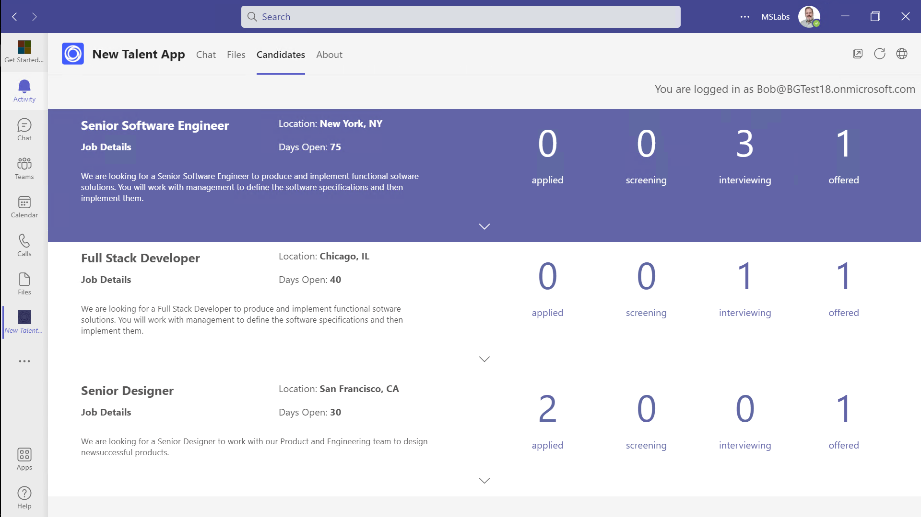
Personal Tabs
A visual user interface that can be navigated and pinned via Teams’ sidebar
This is the personal view of your app – use it to show summaries, settings, specific to this user
Implement as a web page that runs in an IFrame
Discoverability
Employee Experience
User Engagement
Available in Teams side navigation – easier than a bookmark or app launcher tile
Employees can find apps in Teams app store; "featured" by your org or shared by colleagues
Use Teams app policies to auto-install and pin apps for employees who need it
Users and admins can pin apps to the side bar, increasing app usage
All solutions in one place
(preview) Use in Outlook and Office.com as well as in Teams
Notes:
Suggested demo: Show the Northwind Orders personal tab; notice how it shows the user his or her own orders.
This is a typical use of a personal tab – to show users their own personal information.

Slide 15
LAB TIME https://aka.ms/app-camp Please do Lab B-02

Slide 16
Lab B03 Adding Azure AD SSO to your app
Notes:
In this lab, you’ll implement a simple identity linking system that associates Azure AD users with security tokens for users in the app’s native identity provider. This allows users to log in with Azure AD SSO, and the app will work using its existing authorization logic.

Slide 17
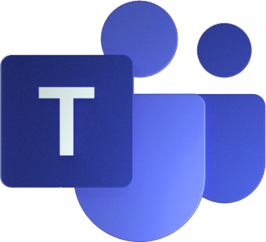
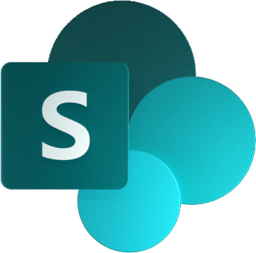

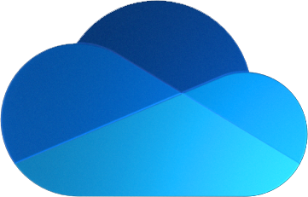
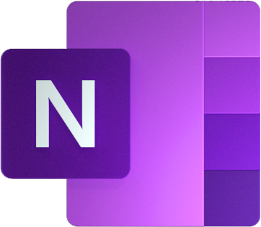


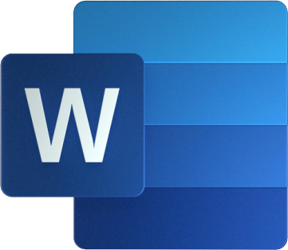
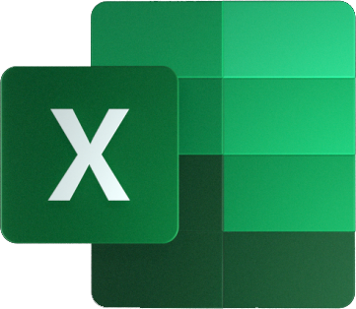

Azure AD
Existing
IdP
Microsoft Teams
SaaS Application
Microsoft Graph
Notes:
At this point, the app works, but there are two identity systems going, one for the SaaS application displayed in Teams and Azure AD for Teams itself and the rest of Microsoft 365. This means that users need to juggle two identities, and anyone who grants permissions within your app will be on their own to figure out which Azure AD users match with the app’s users.

Slide 18
Azure AD
Existing
IdP
Microsoft Teams
SaaS Application
SSO
Microsoft Graph
Identity Mapping logic
Azure AD User ID | Existing IdP token for user
38e43097-cb13-42… | token1
a7775737-9a28-49… | token2
Notes:
A solution that’s been used successfully by many of our partners is a pattern called account linking. When users begin to use the app, they temporarily log into the app’s identity system and Azure AD at the same time using the pop-up approach (or an OAuth bot dialog). The app stores the user’s Azure AD ID along with a token that can be used to act on behalf of that user in the SaaS application. Subsequently, the user can log in using Azure AD SSO. The SaaS application validates the access token provided by Teams SSO and looks up the token for its native identity system.
For simplicity, the sample app just stores the employee ID; this is not a secure approach. Apps should store a refresh token (or something similar) that is validated by the app’s native identity provider rather than bypassing it.

Slide 19
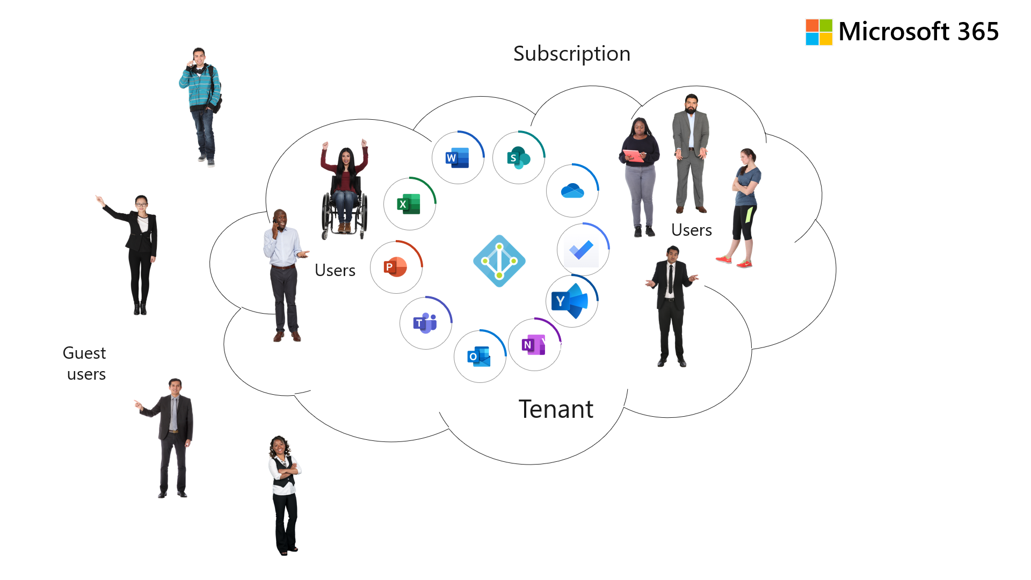
Azure AD Single Sign-On
Users have a single identity across Microsoft 365 and your app
Users seamlessly sign onto your app within Teams, even as they move to new devices
Employee Experience
Security
No extra username and login information to manage
Conforms to each customer’s policies (MFA, conditional access, etc.)
App can access user’s Microsoft 365 content and integrate into application work streams
User Engagement
App can enforce access from approved Teams clients, devices
Collaborators don’t need to navigate a second set of users to share their work
Seamless login across devices
Accounts are managed by IT using established processes
Commercial
Required for Teams App store monetization
Required for Microsoft 365 App Compliance Program
App can write to Teams activity feed to notify users and draw them back to the app
Notes:
Suggested demo: Show the solution to B-02 and how the pop-up login works. Contrast with the SSO solution found in the other labs.
Azure AD SSO is a feature that users don’t see – they just use the app without having to log in again

Slide 20
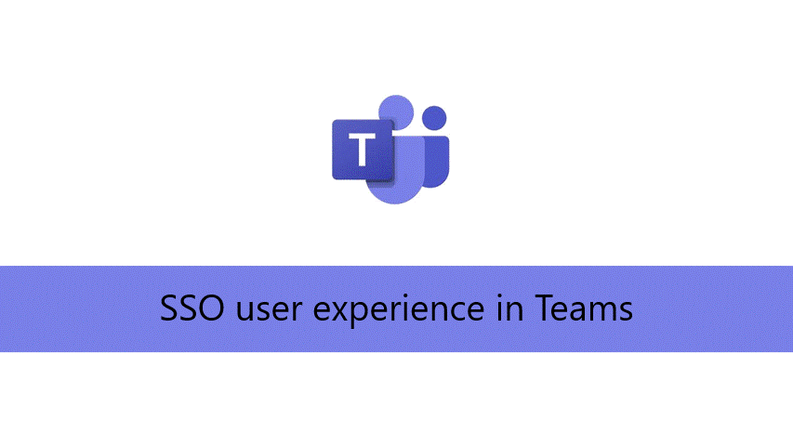
Why do we want to use SSO?
Because SSO enhances the user experience!
User only authenticates one time in Teams
Consent once to access web / desktop / mobile
Improve performances and app load time
Allows authorizing the same set of identities – even using Team membership for authorization MUCH simpler for Team whoever controls permissions!
Notes:
Imagine an app that doesn’t use Azure AD. Such an app can work in Teams but it’s extra trouble for everyone who now needs to juggle two usernames, passwords, etc.
It’s even tougher on admins or whoever is granting permission to the app, because they need to keep track of the alternate user ID for every app user and set their permissions.
Imagine a user leaves the company – will someone remember to remove their access to the app?

Slide 21
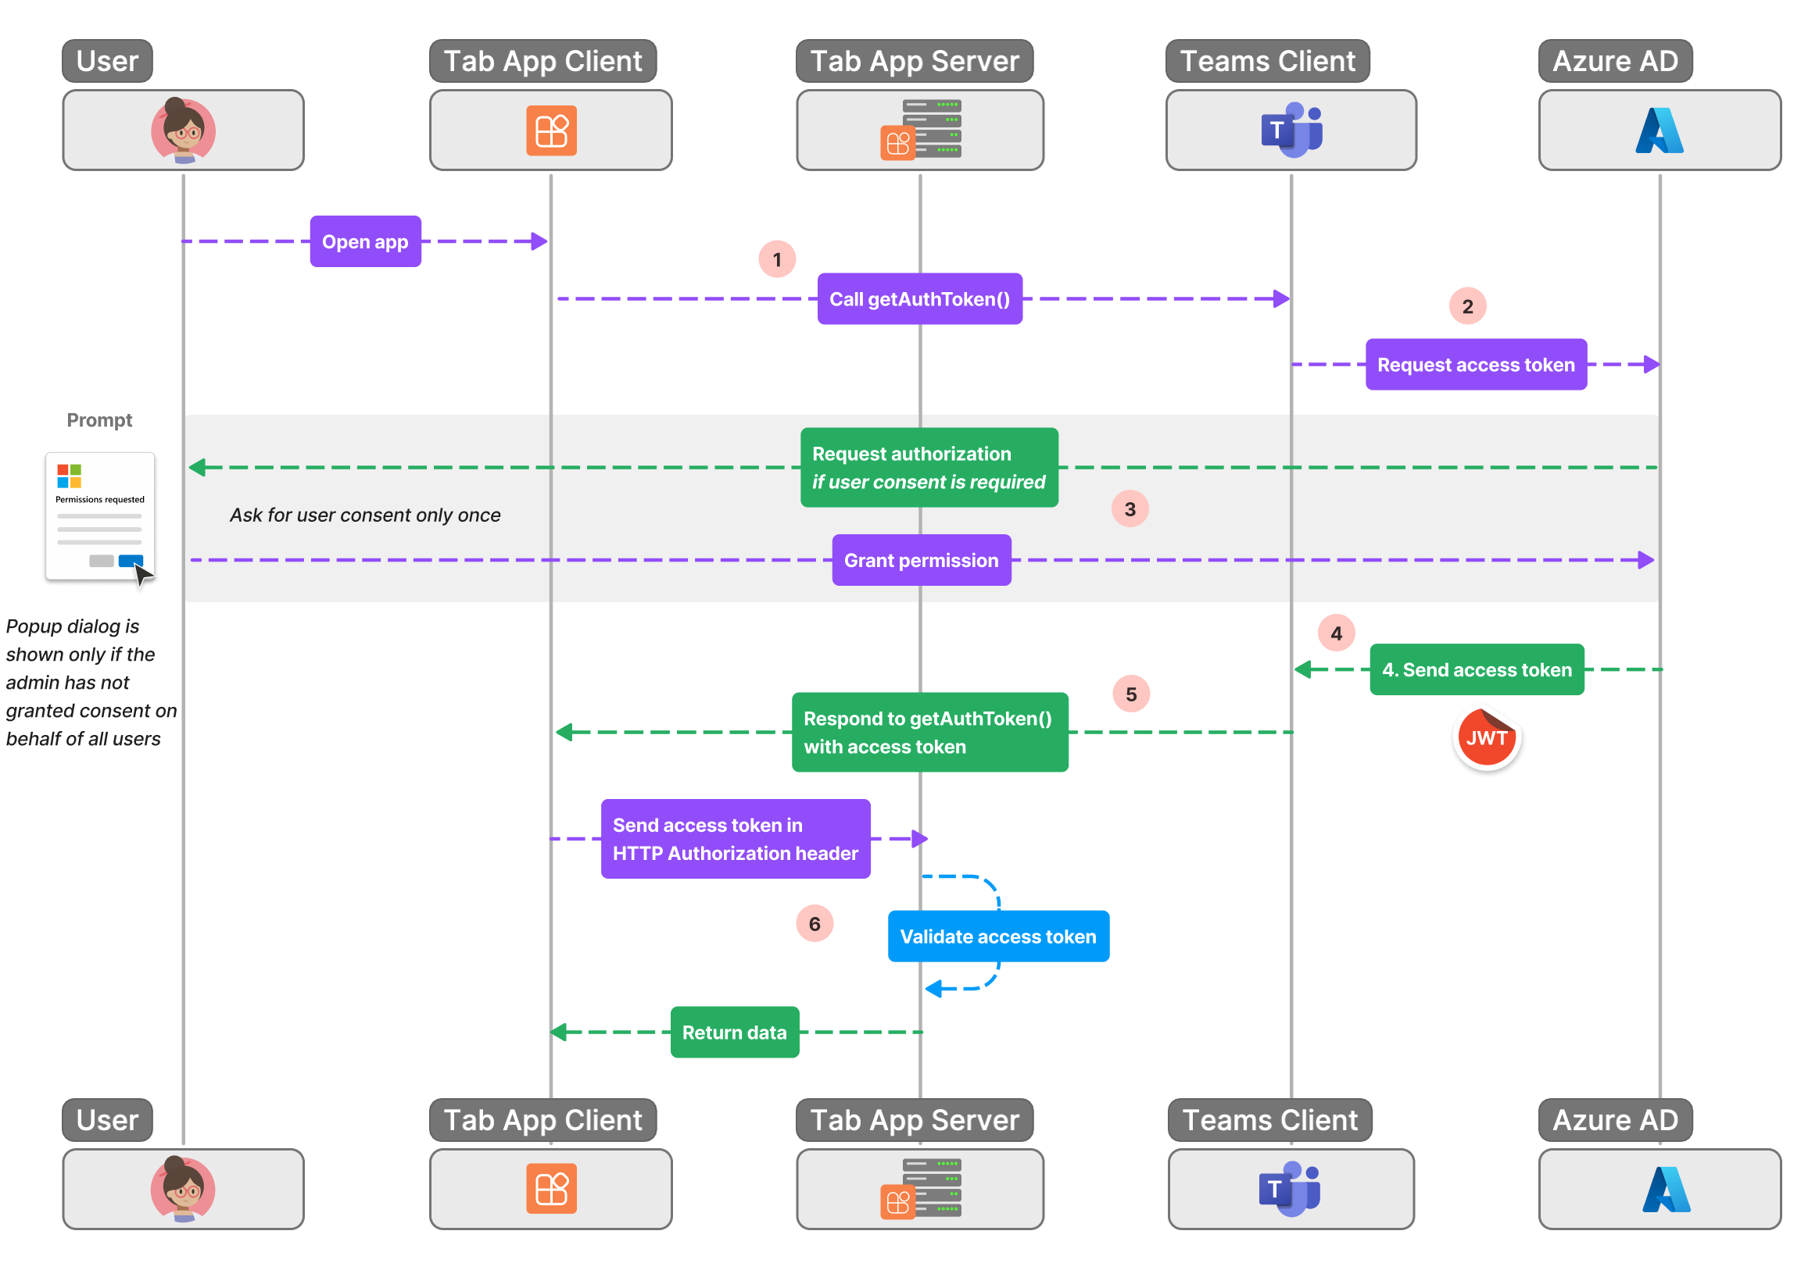
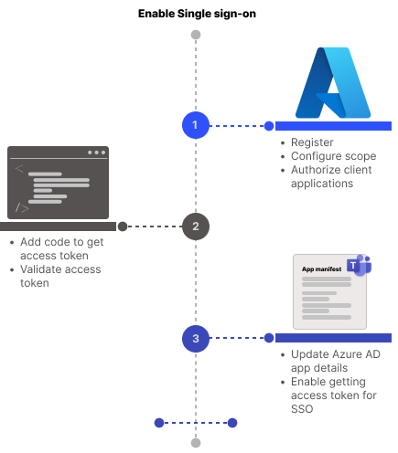
How Teams Tab SSO works
Lab A02
Exercise 1
Lab A02
Exercise 3
Lab A02
Exercise 2
Notes:
Here’s how Teams Tab SSO works. The Teams client is able to request an access token for your app to use in order to call its own back-end server.

Slide 22
demo
Notes:
Lab demonstration:
- Prepare by deleting the northwindDB/IdentityMap.json file if it exists
- In Azure AD show the app registration
- Run the app and click the button to map (link) your Azure AD identity to the Northwind application. Log into the same login popup, but this time the app remembers the linkage. Show this in northwindDB/IdentityMap.json.
- Show the SSO code in /src/create-core-app/bespoke/B03-after-teams-sso/client/identity/aadLogin.js Near the top it calls microsoftTeams.authentication.getAuthToken() to get the Azure AD access token It then calls its own API with that token to obtain a corresponding token with which it can call the native API.

Slide 23
LAB TIME https://aka.ms/app-camp Please do Lab B-03

Slide 24
Lab B04 Teams styling and themes

Slide 25
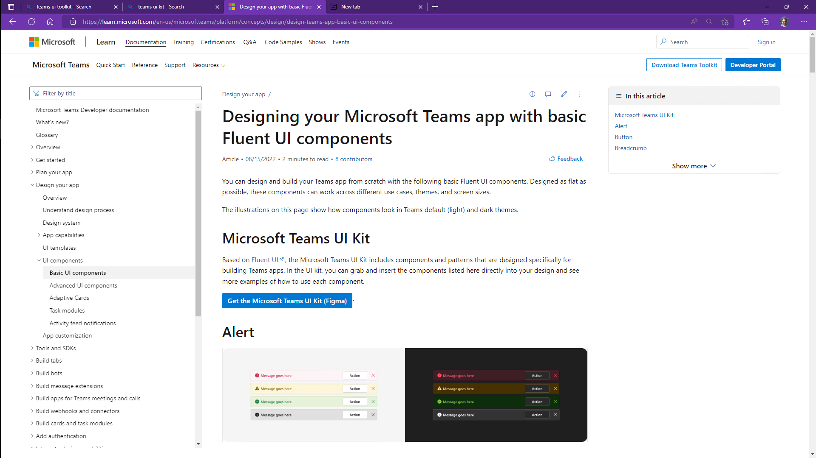
Teams UI Kit
The Teams UI Kit provides Figma UI guidelines and React components that help your app appear consistent with Microsoft Teams
Teams JavaScript API allows apps to follow Teams theme settings
Accessibility
App conforms to user’s choice of light, dark, or high contrast UI
User Engagement
Apps are consistent with Teams UI guidelines
Users are already comfortable with app’s look and feel
Notes:
Suggested demo: Browse to the Teams UI Kit http://aka.ms/teams-ui-kit and drill into the Figma files and look around.
Microsoft has published Teams UI guidelines in Figma, along with a collection of React components.
There is also a community project called HtwoO that provides CSS styles and web controls - https://aka.ms/htwoo

Slide 26
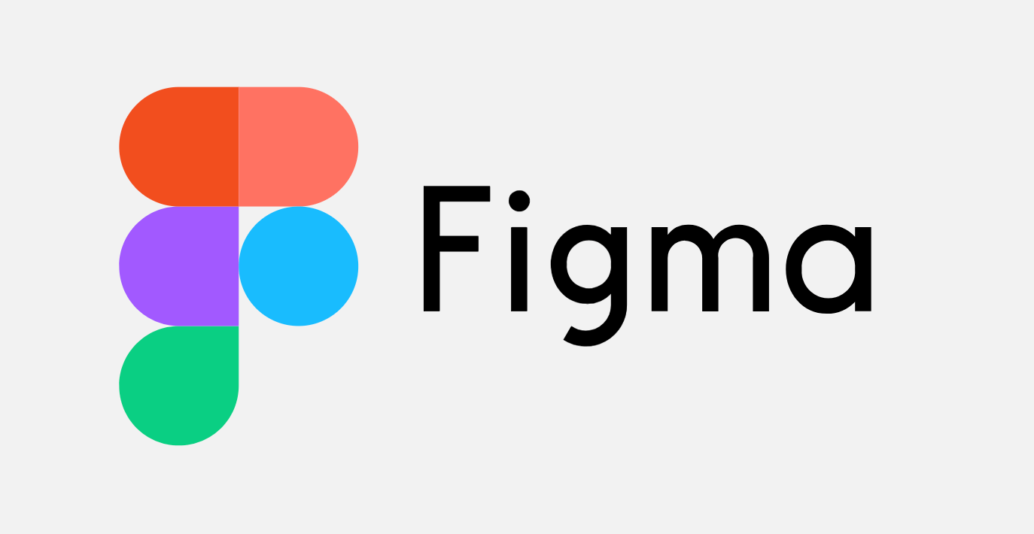
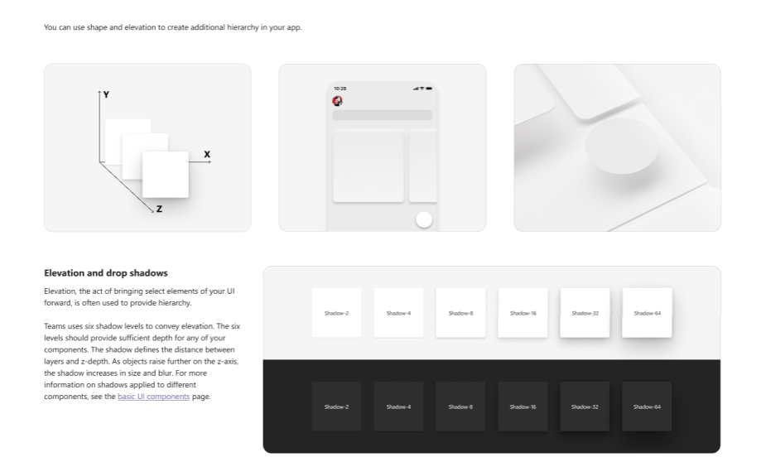
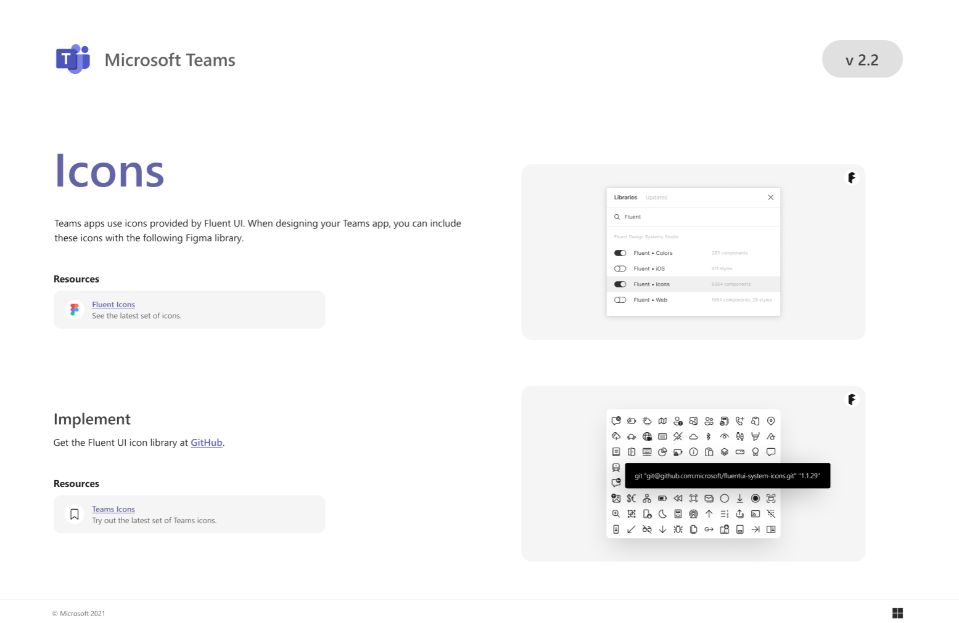
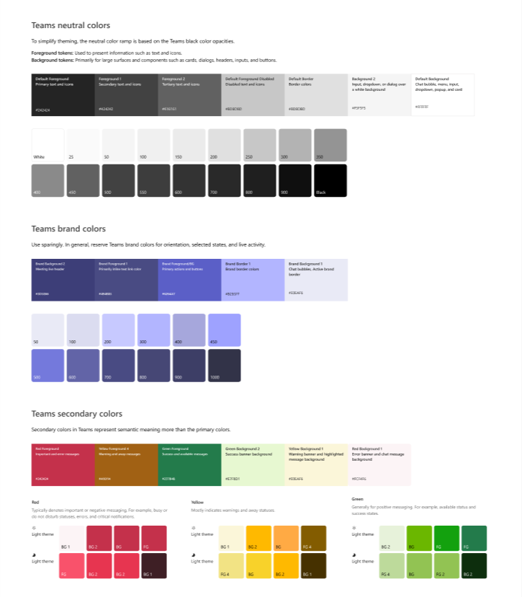
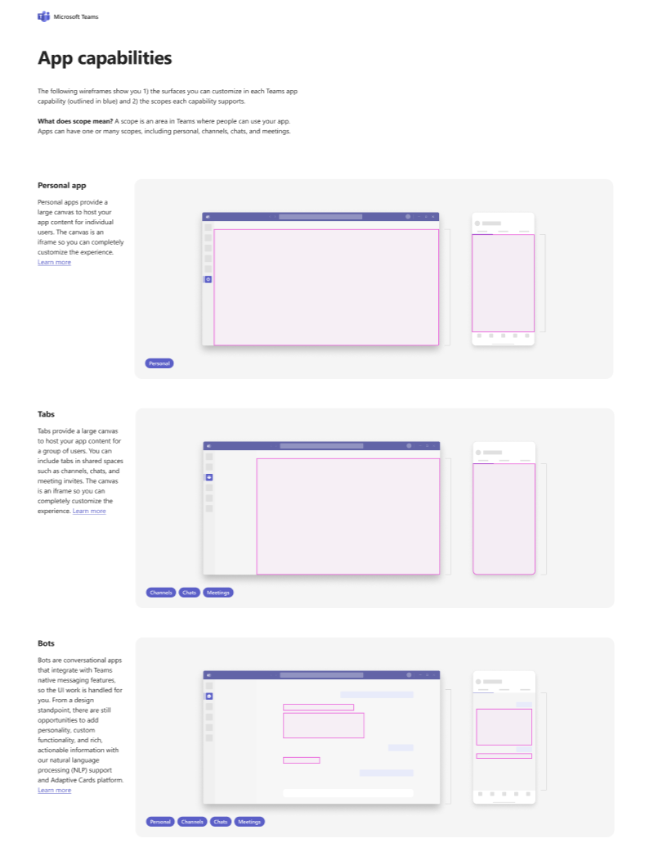
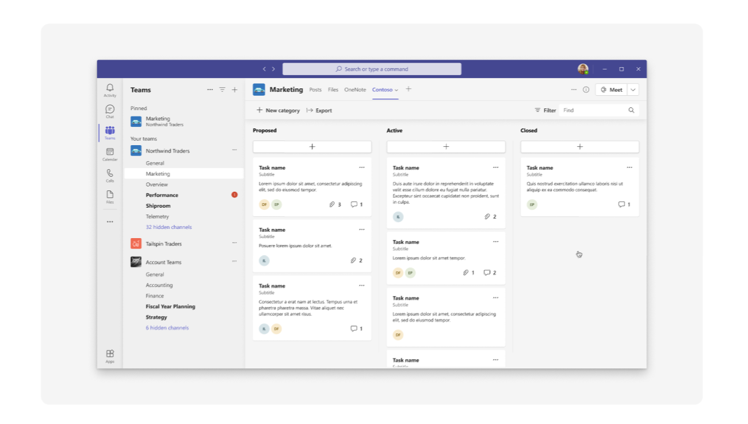
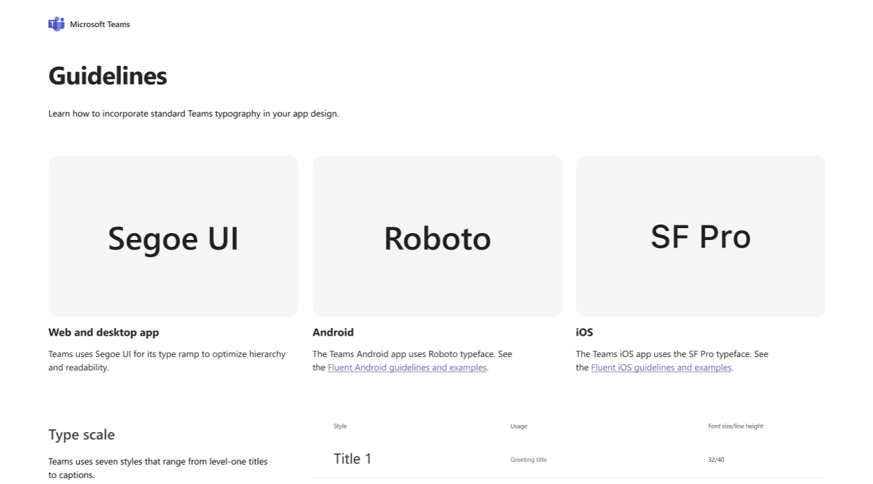
Where can I find Teams themes & styles?
You can get Teams UI kit on
Notes:
Paste the URL to FIGMA Teams UI Kit in the group chat https://www.figma.com/community/file/916836509871353159
Go to FIGMA and navigate throught the tookit (BE PREPARED: FIGMA takes time to load on a web browser)
Go to Layout and show the SAVE / CANCEL buttons
Go to Colors and show the Teams brand colors
Navigate to Teams documentation and show participants that there are other resources, including SDK in REACT
- Designing your app with UI templates - Teams | Microsoft Docs

Slide 27
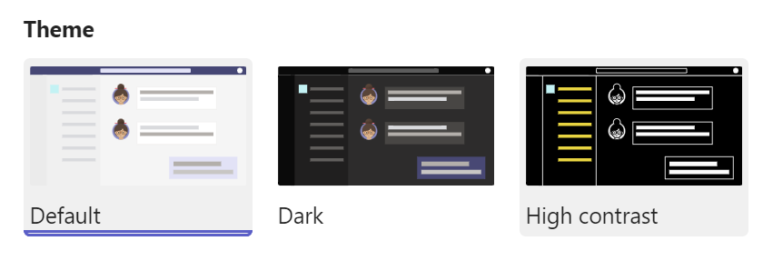
How can I detect MS Teams theme settings?
Microsoft Teams offers 3 different themes:
Default (light) | Dark | High contrast
{
"teamId": "The Microsoft Teams ID in the format 19:[id]@thread.skype",
"teamName": "The name of the current team",
"channelId": "The channel ID in the format 19:[id]@thread.skype",
"channelName": "The name of the current channel",
"chatId": "The chat ID in the format 19:[id]@thread.skype",
"locale": "The current locale of the user formatted as languageId-countryId",
"entityId": "The developer-defined unique ID for the entity this content points to",
"subEntityId": "The developer-defined unique ID for the sub-entity this content points to",
"userPrincipalName": "The principal name of the current user, in the current tenant",
"userObjectId": "The Azure AD object id of the current user, in the current tenant",
"tid": "The Azure AD tenant ID of the current user",
"groupId": "Guid identifying the current Office 365 Group ID",
"theme": "The current UI theme: default | dark | contrast",
"isFullScreen": "Indicates if the tab is in full-screen",
…
}
Your application can get this setting info to adapt the app theme to the user preferences in Teams
To do that context info, we use Teams SDK 2.0 to call the microsoftTeams.getContext() method

Slide 28
LAB TIME https://aka.ms/app-camp Please do Lab B-04
Notes:
Note there is a video for each lab showing a complete walk-through

